Slide 1
Hanif Adam Al Abraar
Nawatech: Technical Test - Machine Learning Engineer
PPT Explanation of Case#1
Sentiment Analysis of Cellular Service Tweets
8 July 2025

Slide 2
Problem & Objective
Problem Statement:
Main Objectives:
Many cellular customer complaints are expressed via social media, requiring an automatic system for sentiment classification.
1
Classify tweets as positive or negative.
2
Extract insights from customer complaints.
3
Develop an end-to-end ML pipeline.

Slide 3
Task 1
preprocessing
Feature_engineering
Model_training
Evaluation
Predictor
Insight_visualization
Model_ensemble (improvement)
Lstm (improvement)
Bert (improvement)
Lstm_predictor
Bert_predictor
Code Explanation
Analayze Data

Slide 4
Pipeline
Code Explanation
Insight extraction
Compare evaluation
Model training
Preprocessing and data exploration
Training various models to find the best one
Deriving meaningful insights from model results
Comparing performance across different models
1
2
3
4
5
6
7
Feature engineering
Evaluation & visualization & Testing predict
Model improvement
TF-IDF, N-gram
Enhancing model accuracy and efficiency
confusion matrix each model and ROC

Slide 5
preprocessing.py
Preprocessing and data exploration
Code Explanation
Clean raw tweet texts for sentiment classification
Generate a clean, structured dataset ready for feature extraction and modeling
Input
Nawatech Dataset
There are 2 Class
IndonesianTextPreprocessor Class
clean_anonymized_tokens() - Removes anonymized tokens like <USER_MENTION>, <URL>, <PROVIDER_NAME>
clean_text() - Applies case folding and removes special characters, hashtags, numbers
remove_stopwords() - Removes stopwords (including Twitter-specific terms)
stem_text() - Applies stemming using the Sastrawi library
tokenize_text() - Tokenizes text into a list of words

Slide 6
preprocessing.py
Preprocessing and data exploration
Code Explanation
Clean raw tweet texts for sentiment classification
Generate a clean, structured dataset ready for feature extraction and modeling
ExploreAndPrepPipeline Class
load_data() - Loads raw CSV dataset
explore_data() - Explores and visualizes sentiment distribution and text length
apply_preprocessing() - Applies full preprocessing pipeline across the dataset
generate_wordcloud() & visualize_data() - Generates word clouds and top words by sentiment
save_processed_data() - Saves the cleaned data to CSV files
Output
Dataset/processed_sentiment_data.csv - Cleaned dataset used for feature extraction (TF-IDF)
Dataset/processed_sentiment_data_tokens.csv - Tokenized version for further analysis
Word cloud images and feature distribution plots

Slide 7
feature_engineering.py
Feature Engineering
Code Explanation
To extract TF-IDF features from preprocessed tweets
To save feature vectors for model training
Input
processed_sentiment_data.csv
Output
sentiment_features.pkl
SentimentFeatureEngineering Class
load_data() - Loads the cleaned CSV file and ensures token column exists
create_tfidf_features() - Generates TF-IDF matrix with unigram & bigram features
save_features() - Saves features and metadata into a .pkl file
run_feature_engineering() - Main pipeline: loads data, extracts TF-IDF, and saves
__main__ - Runs pipeline and performs a train-test split for validation check

Slide 8
model_training.py
Model Training
Code Explanation
Train and evaluate several machine learning models on TF-IDF features
Use 5-fold cross-validation for each model
Save trained models for future prediction and ensemble use
Use 5 Model
Naive Bayes
Random Forest
A simple probabilistic classifier based on Bayes' theorem. It assumes independence between features.
An ensemble learning method that combines multiple decision trees. It improves accuracy and reduces overfitting.
Logistic Regression
XGBoost
A linear model for binary classification using a sigmoid function. It predicts the probability of a binary outcome.
An optimized gradient boosting algorithm for structured data. It is known for its high performance and scalability.
Support Vector Machine
A powerful algorithm that finds the optimal hyperplane. It separates data points into different classes.

Slide 9
model_training.py
Model Training
Code Explanation
Train and evaluate several machine learning models on TF-IDF features
Use 5-fold cross-validation for each model
Save trained models for future prediction and ensemble use
Use 5 Model
Input
sentiment_features.pkl
SentimentModelTrainer Class
load_features() - Loads TF-IDF matrix and labels from .pkl file
_prepare_data() - Splits TF-IDF features into training and testing sets (80/20)
_evaluate_model() - Prints accuracy, classification report, and saves confusion matrix
cross_validate_model() - Runs 5-fold cross-validation and prints F1 macro scores
train_naive_bayes() - Trains a Multinomial Naive Bayes model
train_logistic_regression() - Trains a logistic regression model
train_svm() - Trains a linear SVM classifier
train_random_forest() - Trains a random forest model

Slide 10
model_training.py
Model Training
Code Explanation
Train and evaluate several machine learning models on TF-IDF features
Use 5-fold cross-validation for each model
Save trained models for future prediction and ensemble use
Use 5 Model
SentimentModelTrainer Class
train_xgboost() - Trains an XGBoost model (with label encoding)
save_model(filename) - Saves the current model as .pkl
train_all_models() - Trains and saves all 5 models sequentially
Output
nb_model.pkl, logreg_model.pkl, etc.
confusion_matrix_[model].png
Console Output - Accuracy, F1 score, classification report, cross-validation scores

Slide 11
evaluation.py
Evaluation &visualization &Testing predict
Code Explanation
Evaluate trained machine learning models for sentiment analysis using performance metrics.
Generate visualizations (confusion matrix & ROC curve) for model comparison.
Input
sentiment_features.pkl
model/*.pkl
ModelEvaluator Class
load_features() - Loads TF-IDF matrix and labels from .pkl file
evaluate_model() - Loads a model, makes predictions, prints metrics, and triggers plotting.
_evaluate_model() - Prints accuracy, classification report, and saves confusion matrix
plot_confusion_matrix() - Plots and saves the confusion matrix for model evaluation.
plot_roc_curve() - Plots and saves ROC curve if the model supports probability predictions.
evaluate_all_models() - Evaluates multiple models (NB, Logistic, SVM, RF, XGBoost) sequentially.

Slide 12
evaluation.py
Evaluation &visualization &Testing predict
Code Explanation
Evaluate trained machine learning models for sentiment analysis using performance metrics.
Generate visualizations (confusion matrix & ROC curve) for model comparison.
Output
evaluate/cf_matrix_<model>.png
evaluate/roc_<model>.png
Console Output - Accuracy, F1 score, classification report, cross-validation scores

Slide 13
predictor.py
Evaluation &visualization &Testing predict
Code Explanation
Load a trained sentiment analysis model and predict sentiment from raw user text input.
Apply consistent preprocessing and TF-IDF transformation before prediction.
Input
sentiment_features.pkl
model/*.pkl
SentimentPredictor Class
load_model_and_vectorizer() - Loads the trained model and TF-IDF vectorizer from .pkl files.
predict() - Cleans input text, vectorizes it, predicts sentiment, and decodes labels.
Output
Terminal ouput

Slide 14
Insight_visualization.py
Evaluation &visualization &Testing predict
Code Explanation
Visualize sentiment analysis results to extract insights from tweet data
Generate charts like sentiment distribution, word clouds, and complaint categories.
Input
processed_sentiment_data_tokens.csv
SentimentInsightVisualizer Class
load_data()- Loads and parses tokenized CSV data.
plot_sentiment_distribution() - Creates a bar chart showing sentiment class distribution.
generate_wordclouds() - Generates and saves word clouds per sentiment class.
most_frequent_words() - Shows top-N most common words per sentiment using bar charts.
complaint_category_analysis() - Counts keyword-based complaint categories and visualizes them.

Slide 15
Insight_visualization.py
Evaluation &visualization &Testing predict
Code Explanation
Visualize sentiment analysis results to extract insights from tweet data
Generate charts like sentiment distribution, word clouds, and complaint categories.
Output
insight/sentiment_distribution.png
insight/wordcloud_<sentiment>.png
insight/top_words_<sentiment>.png
insight/complaint_categories.png

Slide 16
model_ensemble.py
Model Improvement
Code Explanation
Build an ensemble model (Voting Classifier) using multiple pre-trained models.
Evaluate ensemble performance and save the final ensemble model.
Input
sentiment_features.pkl
Model/*.pkl
EnsembleModelTrainer Class
load_features() - Loads TF-IDF features and labels from a pickle file..
load_model(path) - Loads an individual model from a .pkl file.
_evaluate_model() - Computes classification metrics and saves confusion matrix plot.
train_voting_from_existing() - Builds a hard-voting ensemble using 5 existing models and fits it.
save_model() - Saves the trained ensemble model to disk.

Slide 17
model_ensemble.py
Model Improvement
Code Explanation
Build an ensemble model (Voting Classifier) using multiple pre-trained models.
Evaluate ensemble performance and save the final ensemble model.
Output
voting_model_from_existing.pkl
conf_matrix_voting_classifier_(...).png
Terminal Output

Slide 18
lstm.py
Model Improvement
Code Explanation
Train a deep learning model (LSTM) for binary sentiment classification.
Save the trained model and tokenizer for future predictions.
Input
processed_sentiment_data.csv
LSTMTrainer Class
load_features() - Loads TF-IDF features and labels from a pickle file..
preprocess() - Tokenizes and pads sequences for LSTM input.
build_model() - Defines the LSTM architecture using Keras.
train() - Splits data, trains the model, applies early stopping, and saves outputs.
Output
lstm_model.h5
tokenizer_lstm.pkl

Slide 19
Lstm_predictor.py
Model Improvement
Code Explanation
Load a pre-trained LSTM model and tokenizer to predict sentiment from new input text
Return both predicted label and probability score.
Input
lstm_model.h5
tokenizer_lstm.pkl
User input text
LSTMPredictor Class
_load_model_and_tokenizer() - Loads .h5 model and tokenizer.pkl for inference.
predict(text) - Converts input to sequence, pads, and returns sentiment & confidence score.
Output
Displays sentiment (`positive`/`negative`) and confidence score

Slide 20
bert.py
Model Improvement
Code Explanation
Fine-tune a pre-trained IndoBERT model for sentiment classification on Bahasa Indonesia text.
Save the final model and tokenizer for later inference.
Input
processed_sentiment_data.csv
indobert-base-p1
BERTTrainer Class
load_data() - Loads labeled CSV data and encodes sentiments as numerical labels.
tokenize() - Tokenizes input text for BERT (with padding/truncation).
train() - Prepares dataset, tokenizes, fine-tunes BERT, evaluates, and saves model.
Output
model/bert/
Accuracy and training logs via HuggingFace Trainer.

Slide 21
Bert_predictor.py
Model Improvement
Code Explanation
Perform sentiment prediction using a fine-tuned BERT model.
Return both the predicted label (positive/negative) and confidence score.
Input
model/bert/
User input text
BERTPredictor Class
__init__() - Loads the fine-tuned BERT model and tokenizer from local directory.
predict(text) - Tokenizes input text, runs inference, and returns sentiment prediction.
train() - Prepares dataset, tokenizes, fine-tunes BERT, evaluates, and saves model.
Output
Shows sentiment label and prediction confidence..

Slide 22
Final_evaluation.py
Compare Evaluation
Code Explanation
Evaluate and compare all models (Classic ML, Ensemble, LSTM, BERT) on the same test set.
Generate classification reports and confusion matrices to benchmark performance.
Input
processed_sentiment_data.csv
Pkl model, h5 model, bert model
Output
Confusion matrix for each model’s predictions.
Load Dataset - Reads processed text and true sentiment labels.
evaluate_and_print() - Centralized evaluation: prints metrics and saves confusion matrix.
Classic ML Evaluation - Loads 5 pre-trained models and evaluates them using TF-IDF
Voting Ensemble - Loads ensemble model (VotingClassifier) and evaluates it.
LSTM - Loads LSTM model + tokenizer, predicts, and evaluates.
BERT - Tokenizes all inputs, runs BERT model, and evaluates predictions.

Slide 23
Analyze Data

Slide 24
Model Evaluation
Our models were evaluated using an 80:20 train-test split and 5-fold Cross-Validation to ensure robust and reliable performance metrics.
Model | Accuracy | F1 Macro (CV) | Std Dev
Naive Bayes | 85.0% | 0.7885 | ±0.0533
Logistic Regression | 86.7% | 0.7592 | ±0.0713
SVM (Linear) | 91.7% | 0.7925 | ±0.0561
Random Forest | 83.3% | 0.7514 | ±0.0897
XGBoost | 73.3% | 0.6903 | ±0.0624
🥈
SVM achieved the highest accuracy (91.7%) and strong cross-validation F1, making it the top performer.
Naive Bayes was simple yet reliable
🥉
🥇

Slide 25
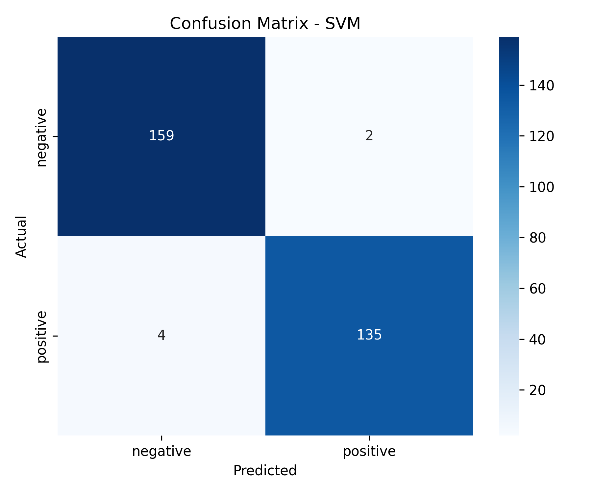

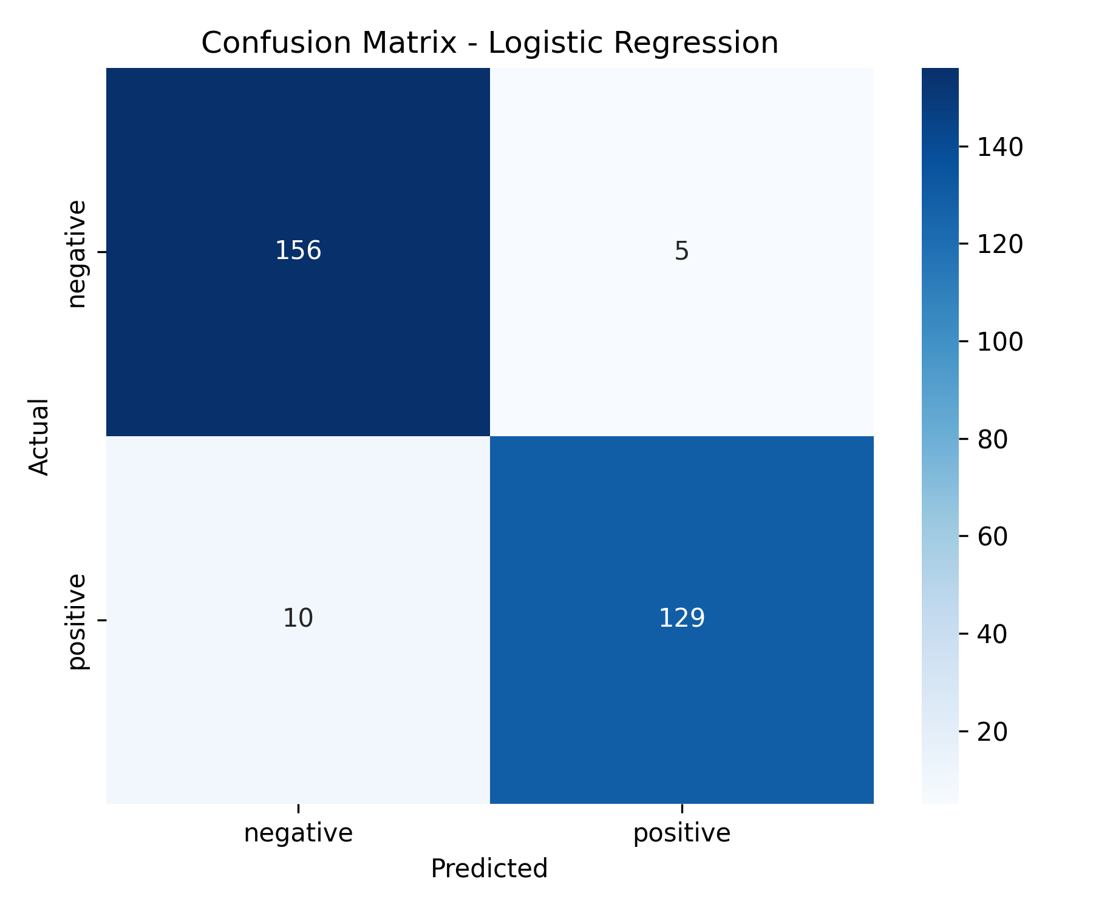

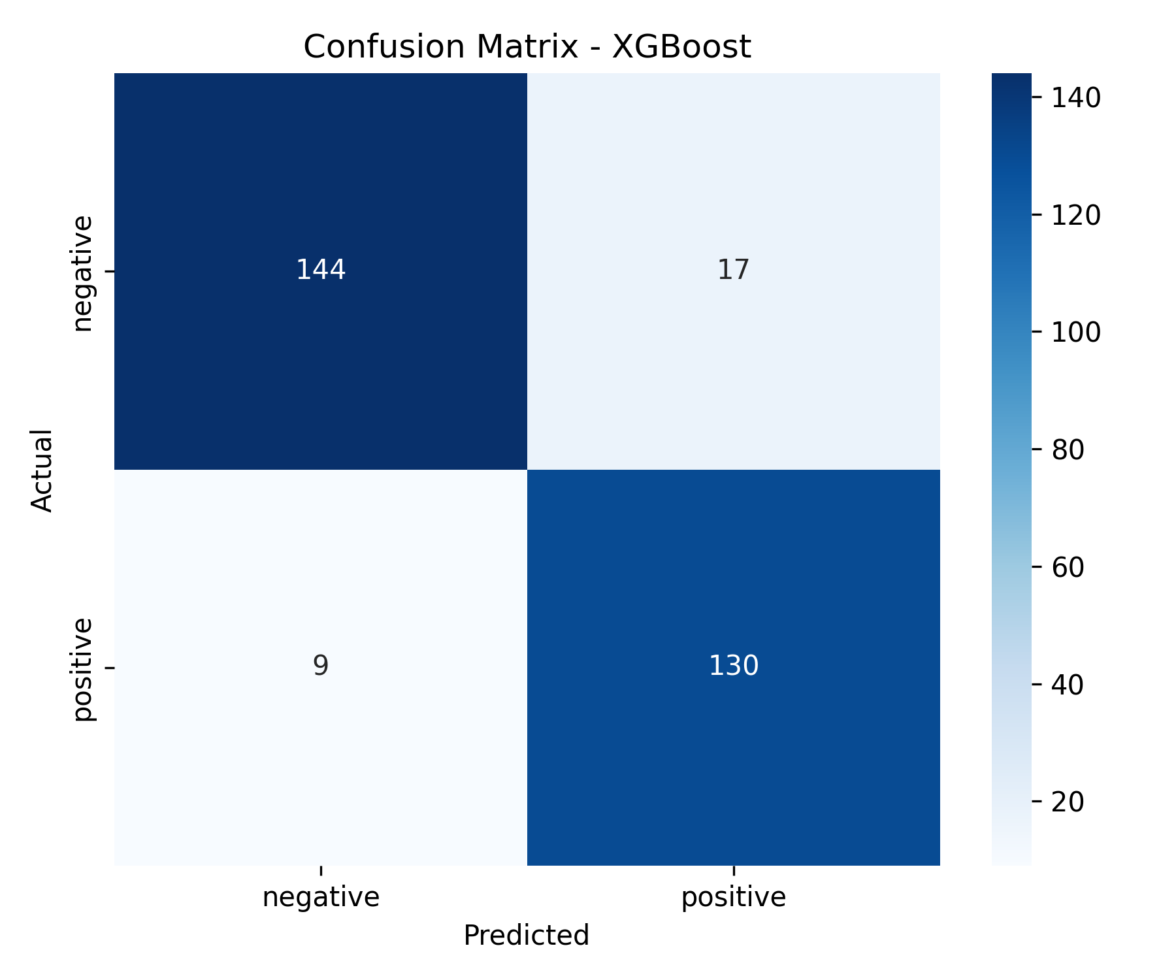
🥇
🥈
🥉

Slide 26
Task 2
Ensemble Model
LSTM
BERT
Insight from Data
Improvement

Slide 27
Insight from Data

Slide 28
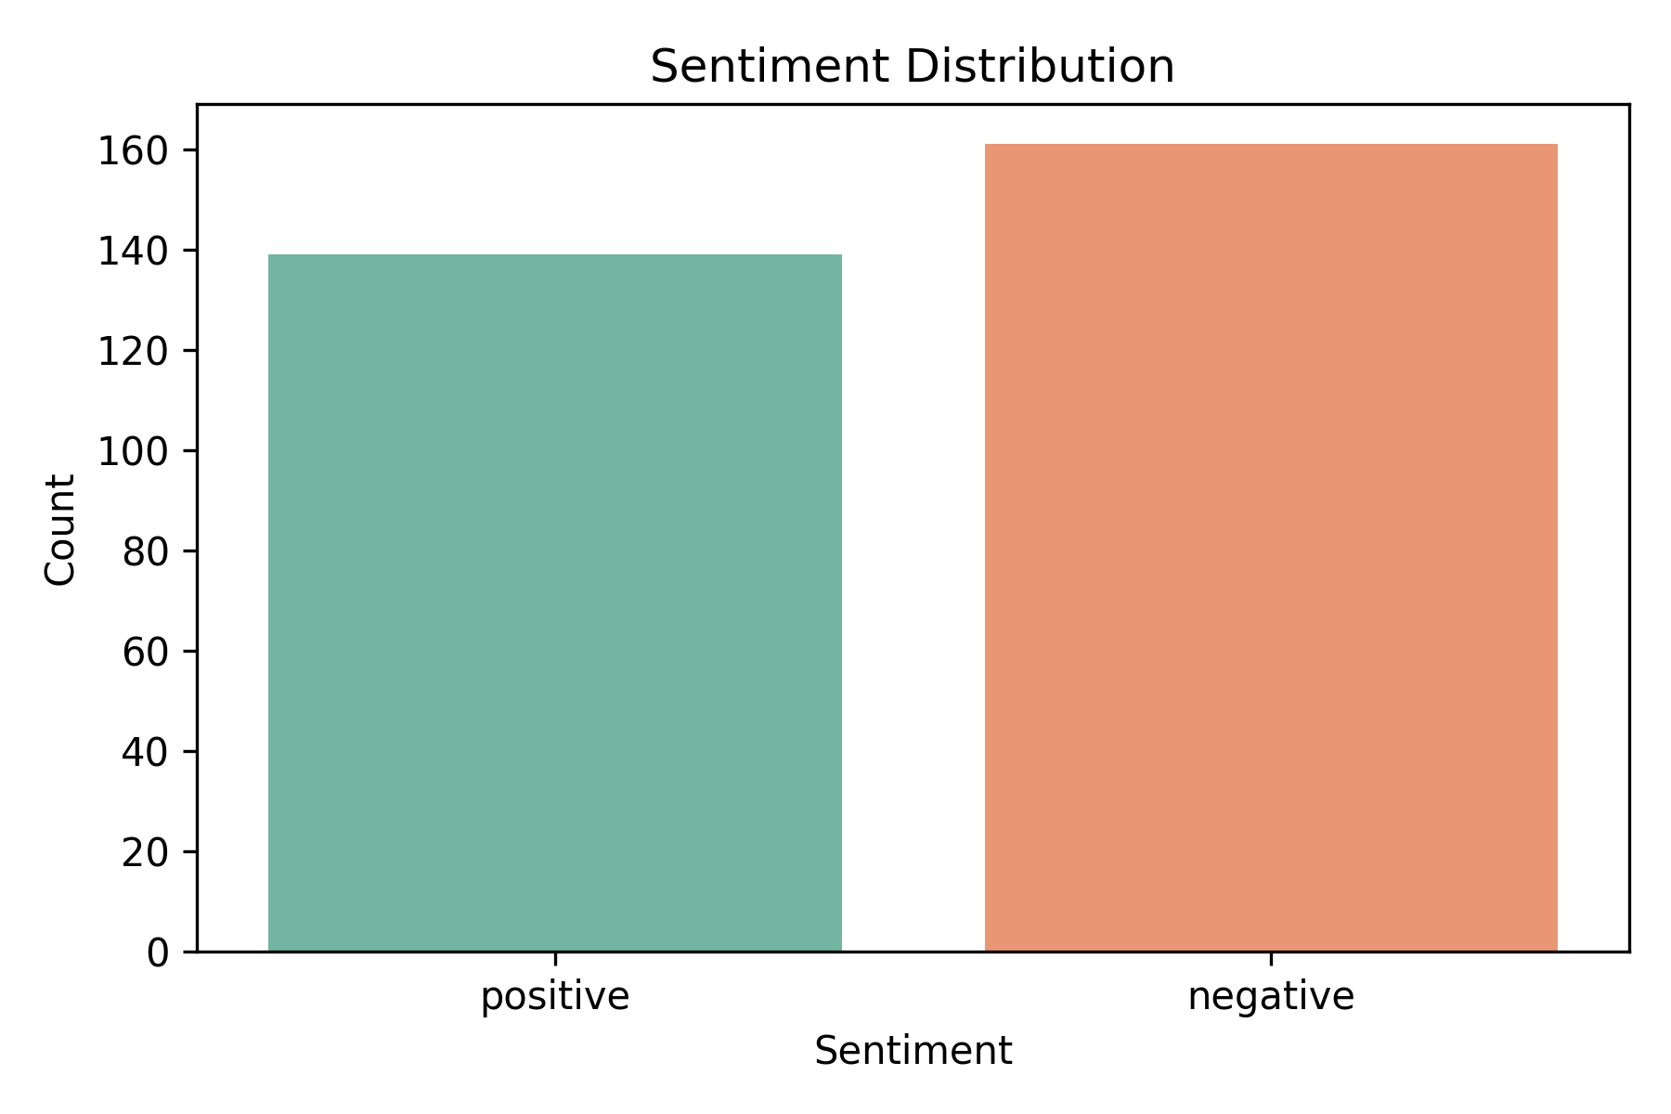
Key Insights from the Dataset
Beyond sentiment classification, extracted valuable insights from the tweet data, revealing key patterns in customer feedback.
1. 🔺 Negative sentiment dominates
~60% of tweets express dissatisfaction — indicating service quality is a major concern.

Slide 29
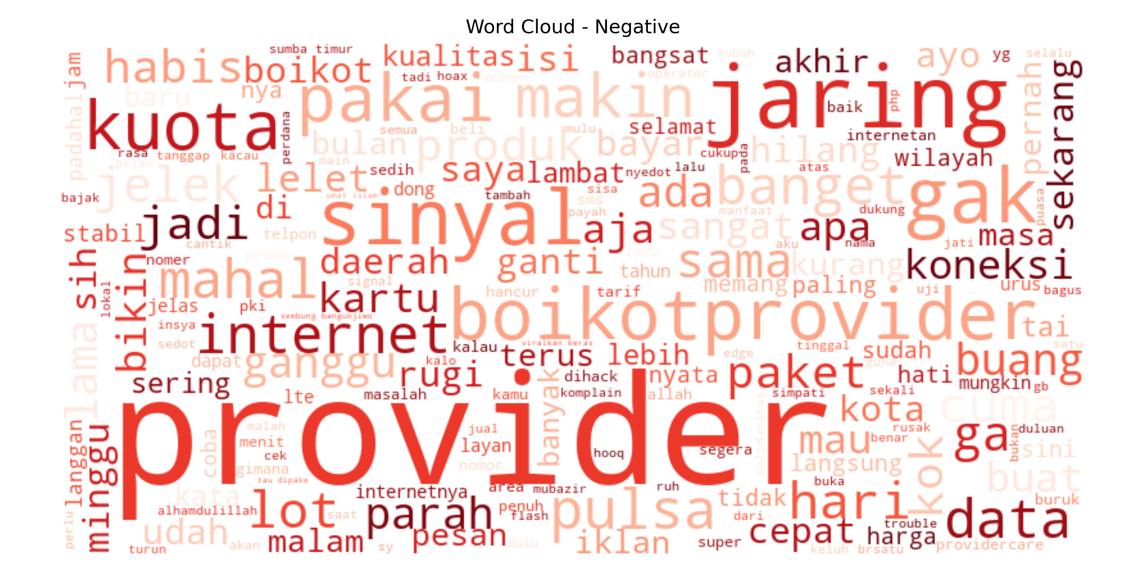
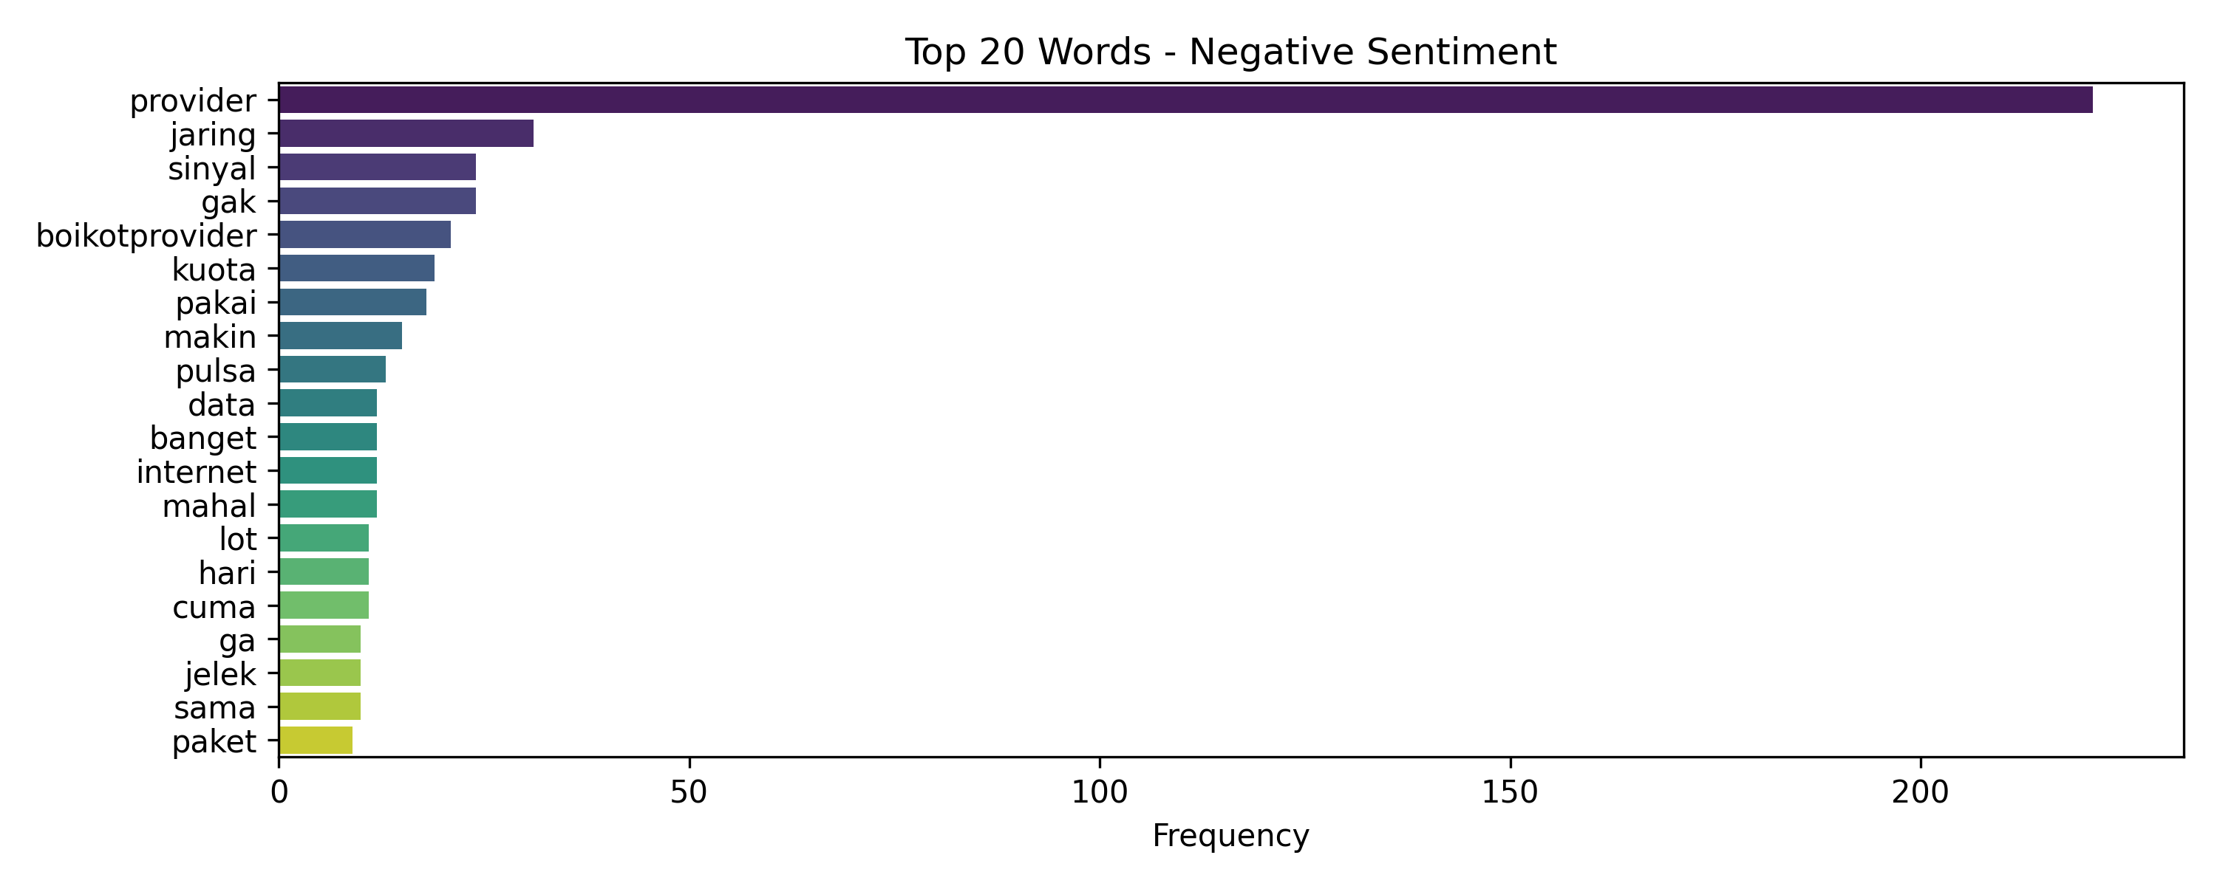
Key Insights from the Dataset
Beyond sentiment classification, extracted valuable insights from the tweet data, revealing key patterns in customer feedback.
2. Most frequent negative keywords:
if we exclude the word provider
Pointing to network and signal

Slide 30
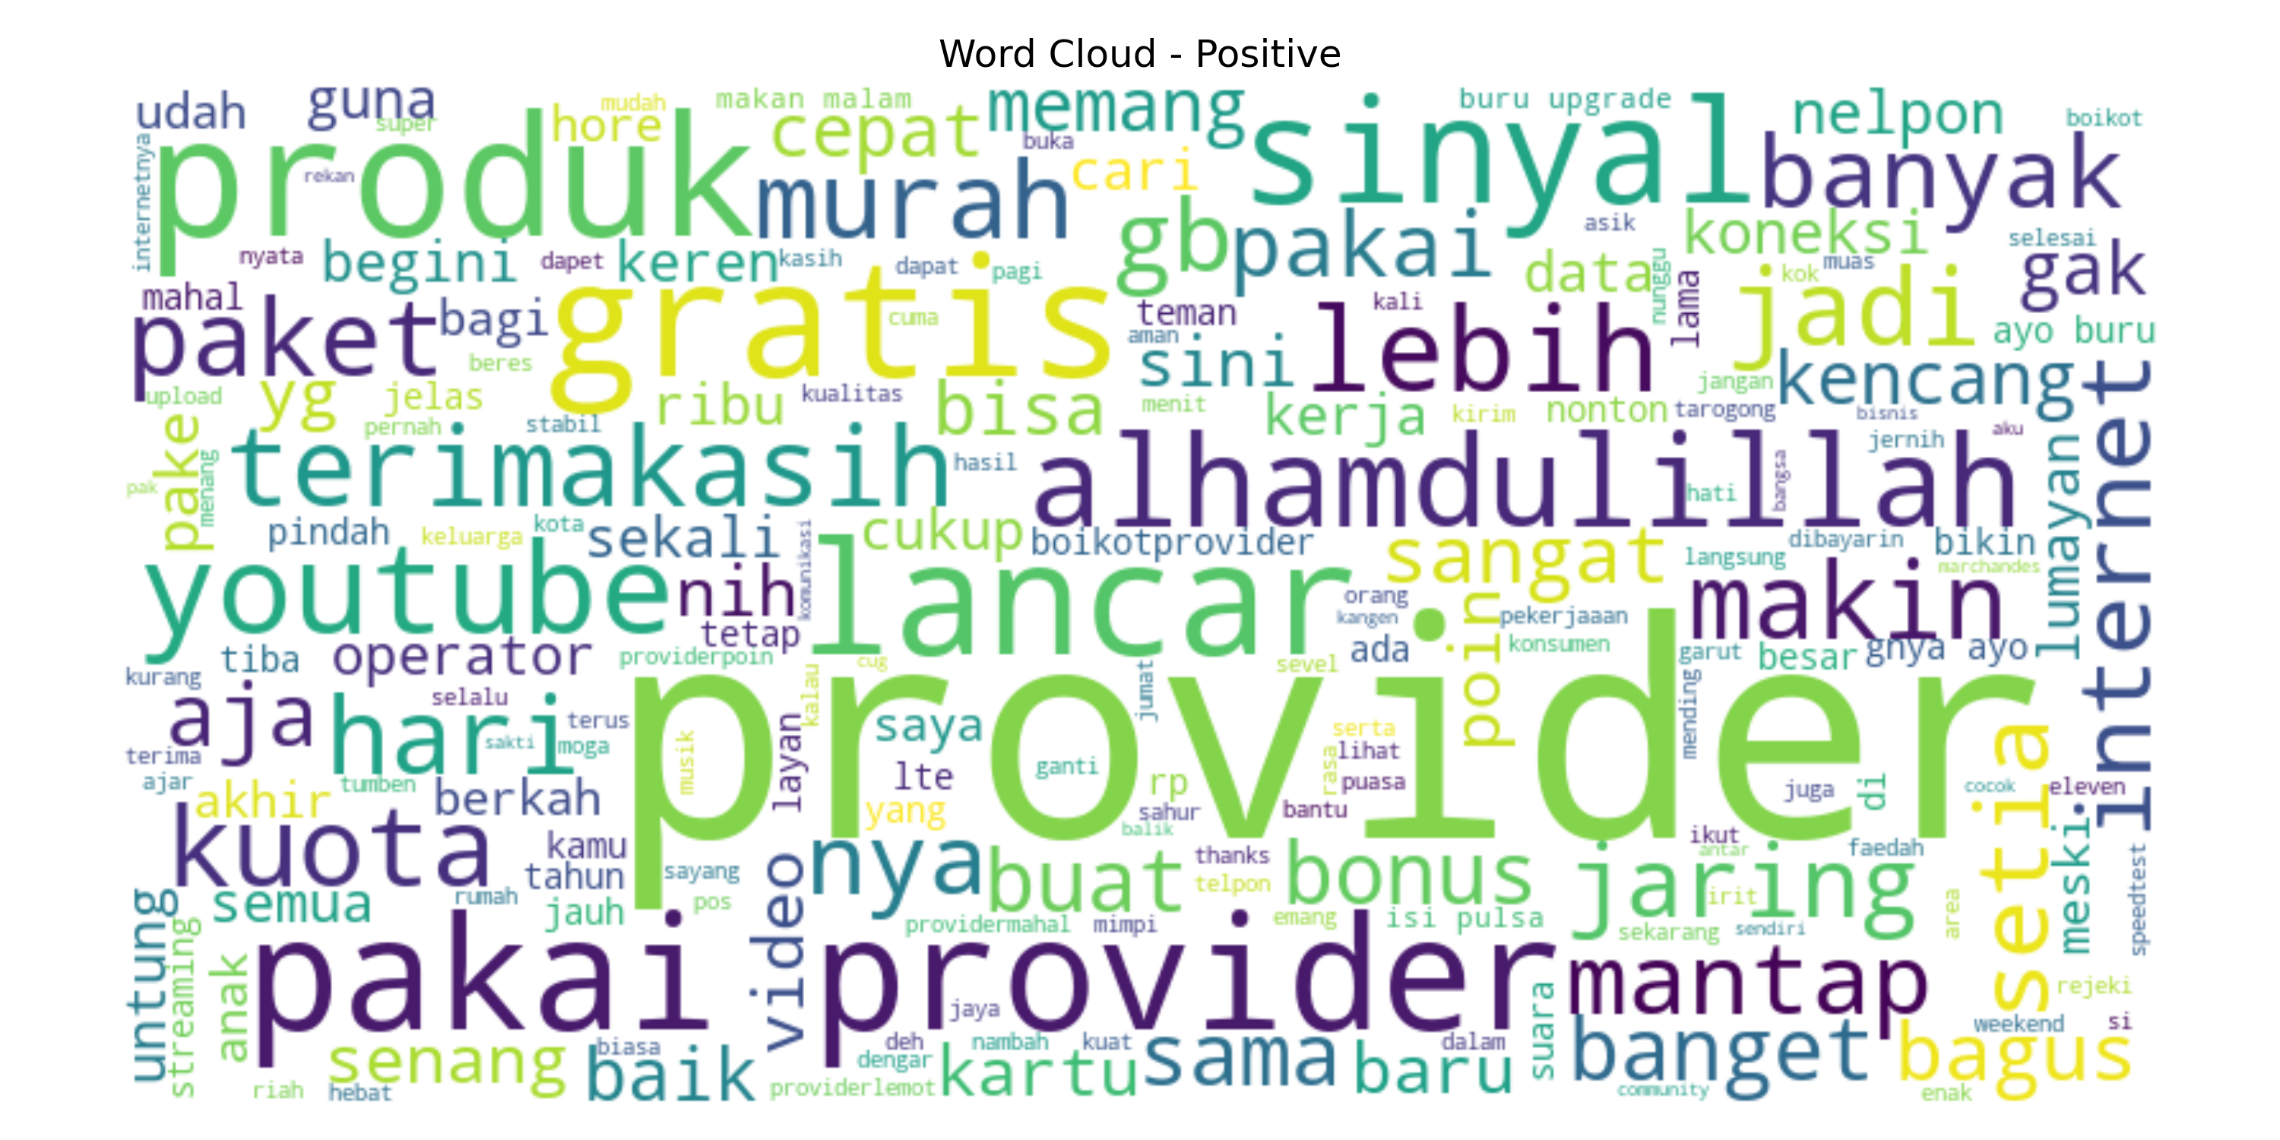
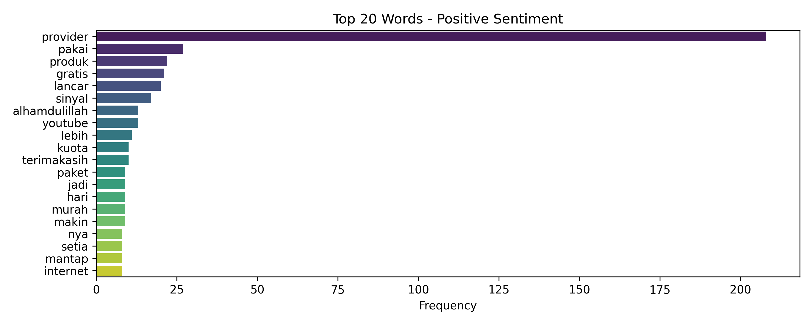
Key Insights from the Dataset
Beyond sentiment classification, extracted valuable insights from the tweet data, revealing key patterns in customer feedback.
3. Positive tweets mostly contain:
if we exclude the word provider
Often about restored service or successful help.

Slide 31
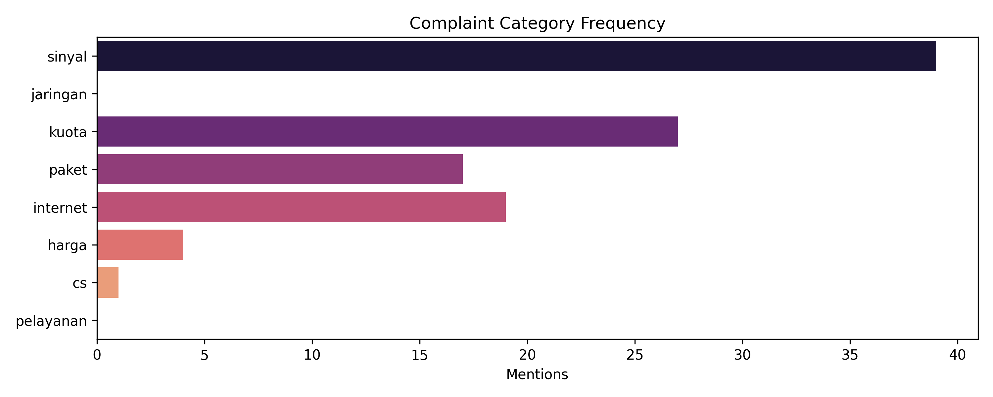
Key Insights from the Dataset
Beyond sentiment classification, extracted valuable insights from the tweet data, revealing key patterns in customer feedback.
4. Common complaint categories (manual grouping):
Majority of customer dissatisfaction revolves around network and signal reliability.
These insights can guide the provider’s technical and customer service teams to prioritize improvements.

Slide 32
Improvement
Although classical models performed well, they have limitations in understanding context and word order. Therefore, I experimented with ensemble learning, LSTM, and BERT to explore deeper language representations.

Slide 33
Comparation Evaluation Summary
Model | Accuracy | Notes
Naive Bayes | 93.7% | Lightweight & stable
Logistic Regression | 95.0% | Interpretable, well-balanced
SVM (Linear) | 98.0% | Top performer (classical)
Random Forest | 96.3% | High accuracy, more variance
XGBoost | 91.3% | Underperformed
Voting Ensemble | 99.3% | ✅ Highest overall accuracy
LSTM | 53.7% | ❌ Severe class imbalance, poor result
BERT | 98.0% | ✅ Equal to SVM, very strong contextual understanding
The earlier evaluation used an 80/20 train-test split for cross-validation and initial model testing.
The final comparison, however, was performed on the entire dataset to ensure fair and consistent benchmarking across all models, including ensemble, LSTM, and BERT.
🥈
🥇
🥈

Slide 34
Comparation Evaluation Summary
✅ Voting Ensemble significantly boosted accuracy by combining strengths of multiple classifiers.
⚠️ LSTM failed to generalize, likely due to lack of data, poor balance, or insufficient tuning.
🧠 BERT performed excellently, matching SVM with better context handling, despite being pretrained on general Indonesian corpora.
💡 SVM remains the best trade-off between performance and simplicity in the classical setup.
Ensemble and transformer-based models (BERT) offer the best results
but classical models like SVM remain very competitive when resources or latency are a concern.

Slide 35

Comparation Evaluation Summary
🥇
🥈

Slide 36
Thank You

